Slide 1
PADS EXTENSION
Ivy Min, Purboday Ghosh, Veena Nalluri
CS 6388-01: Model-Integrated Computation
Project Sponsors: Yogesh Barve, Dr. Aniruddha Gokhale

Slide 2
Background & Motivation
PADS stands for Playground of Algorithms for Distributed Systems. It is an extensible framework that leverages the DSML capabilities of WebGME, allowing users to design, modify, implement, prototype and deploy distributed algorithms by abstracting the low level implementation details.
Currently, PADS is capable of allowing users to design different network topologies and then simulate them using a standard testbed such as Mininet. It is essentially a “run and observe” functionality with no scope of modifying the link parameters after creation.
Our project aims at bridging that gap to allow behavioural modeling of the topologies within PADS.

Slide 3
Problem characterization
Develop experiment and deployment meta model
Implementing a behavior FSM model
Develop the plugin for FSM model for generating Json file
Modifying the plugin for Topology model for generating python file
Writing a python file for link updating
Using Word Counting example based on MapReduce model for testing updating of link properties.

Slide 4
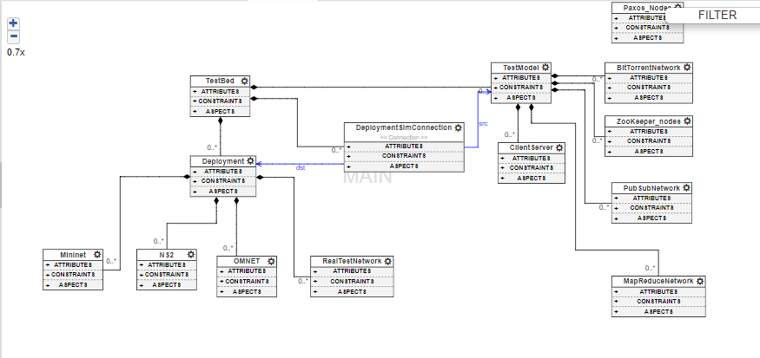
Current PADS Metamodel

Slide 5
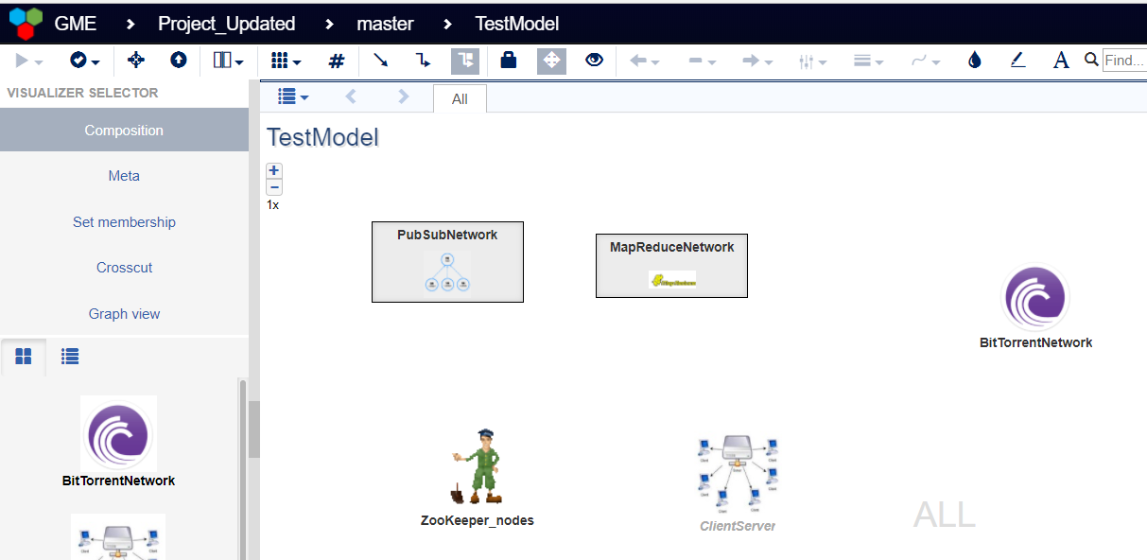
Test Models
Test Models supported by PADS at present

Slide 6
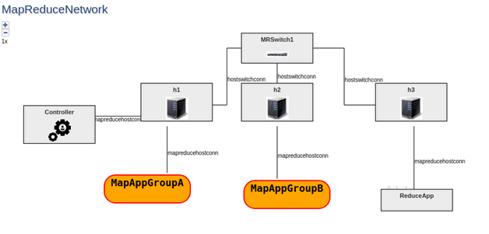
Map Reduce Network
A distributed algorithm consisting of mappers implementing filtering of data into collections and reducers operating on those collections.

Slide 7
Methodology - WebGme part
Modeling and Metamodeling
Topology model - This is the legacy model which is currently offered by PADS. Users can define hosts, switches, links etc.
Behaviour model - The behaviour model meta was integrated into the already existing PADS metamodel framework. Each state defines link objects and link properties to be updated with time intervals acting as the guard conditions.
Plugin
CreateTopology / mrMininet: topology.py file which can be run on mininet to create a network topology.
GenerateBehaviourModel (new): FSM.json. It generates a collection of states containing the link attributes to be updated along with their associated guards.

Slide 8
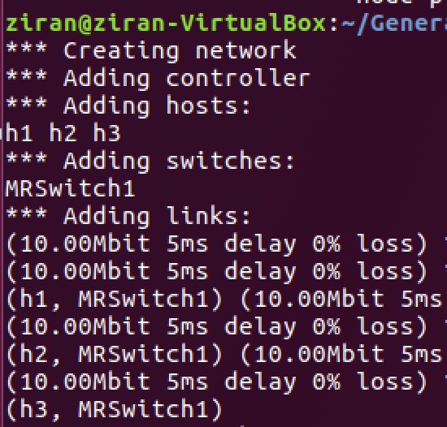
Methodology - Mininet part
WEBGME
MININET
JavaScript File
JavaScript File
Plugins
Plugins
Run
Meta Json File
Python File
creating a customized network topology
Input
Run
Update links’ properties
Python File
dynamic changing the link properties

Slide 9
Methodology - Mininet part
Word Counting example based on MapReduce model
Deficiency exists
The differences is not obvious
TCP protocol can handle the loss and delay in a range
link1
link3
Switch1
link2
h1
h2
h3
Master
Map
Reduce

Slide 10
Performance Benchmarks
Using Iperf() method to test bandwidth
h1 and h2 39.4 Gbits/sec
h1 and h3 37.5 Gbits/sec
h2 and h3 32.5 Gbits/sec
h1 and S1 bw=1000
h1 and h2 474 Mbits/sec
h1 and h3 537 Mbits/sec
h2 and h3 27.0 Gbits/sec
h2 and S1 bw=100
h1 and h2 8.91 Mbits/sec
h1 and h3 9.49 Mbits/sec
h2 and h3 89.9 Mbits/sec
h1 and S1 bw=10
h1 and h2 643 mbits/sec
h1 and h3 608 mbits/sec
h2 and h3 89.9 Mbits/sec

Slide 11
Insights & Conclusions
Challenges faced:
Updating the ejs file topologyFileTemplate.ejs for the CreateTopology and mrMininet plugins.
Decorators not loading for any of the newly defined as well as default models.
Future work:
In future, we would like to run the program for other distributed systems such as publish-subscribe, client-server, bittorrent etc.
Implement the application as a Design Studio to abstract the metamodels from the end users.
Writing constraints.

Slide 12
Demonstration
WebGME demonstration
Mininet demonstration

Slide 13

Thank you !

